Slide 2
Course Overview
Day 1: Introduction to ML, Model Building, Text Processing, Bag of Words (BoW), and K Nearest Neighbors Model (KNN)
Day 2: Tree-based Models, Regression Models, Optimization, Regularization, Hyperparameter Tuning, and AWS AI/ML Services
Day 3: Neural Networks, Word Embeddings, Recurrent Neural Networks (RNN), and Transformers
Day 4: Tabular Data, AutoML, Image Classification, Convolutional Neural Networks (CNN), and Transfer Learning

Slide 3
Topics for Day 1
Introduction to Machine Learning
Data Processing
Model Evaluation Metrics
Text Processing
Bag of Words Method (BoW)
K Nearest Neighbors Model (KNN)
Final Project

Slide 4
Topics for Day 1
Introduction to Machine Learning
Data Processing
Model Evaluation Metrics
Text Processing
Bag of Words Method (BoW)
K Nearest Neighbors Model (KNN)
Final Project

Slide 5
What is Data Science?
Machine Learning
Wikipedia describes Data Science as:
“a multi-disciplinary field that uses scientific methods, processes, algorithms and systems to extract knowledge and insights from structured and unstructured data.”
MACHINE LEARNING
MATHEMATICS
COMPUTER
SCIENCE
DATA
SCIENCE
STATISTICAL
RESEARCH
DATA
PROCESSING
DOMAIN
EXPERTISE
https://en.wikipedia.org/wiki/Data_science

Slide 6


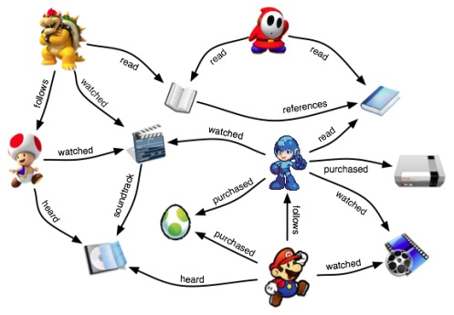

Why Machine Learning?
Some programs are difficult or impossible to write explicitly
We may not know how (task too complex), e.g., face recognition
Too much relevant data, e.g., stock market prediction
Relevant information may only become available dynamically, e.g., a recommendation system
Humans handle this by improving based on experience (data)

Slide 7
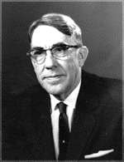
What is Machine Learning?
“The field of study that gives computers the ability to learn without being explicitly programmed”
Arthur Samuel Pioneer of AI research
Data
Classical Programming
Machine Learning Algorithm
Machine Learning Model (Rules)
Answers
Data
Answers
Rules
Problem
Data
Algorithm
Model
Output

Slide 8
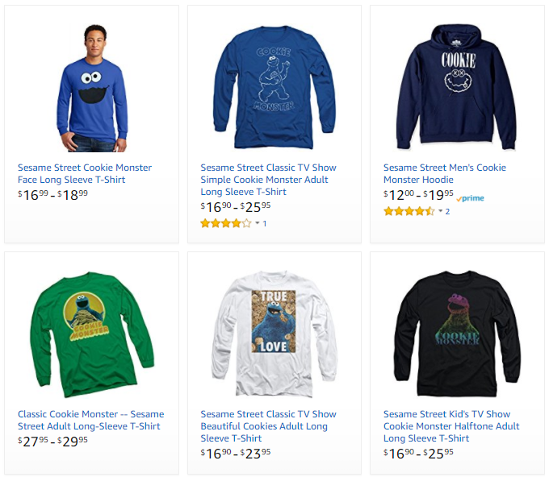
Machine Learning Problems
Problem type
Description
Example
Ranking
Helping users find the most relevant thing
Ranking algorithm within Amazon Search
Recommendation
Giving users the thing they may be most interested in
Classification
Figuring out what kind of thing something is
Regression
Predicting a numerical value of a thing
Clustering
Putting similar things together
Anomaly Detection
Finding uncommon things

Slide 9
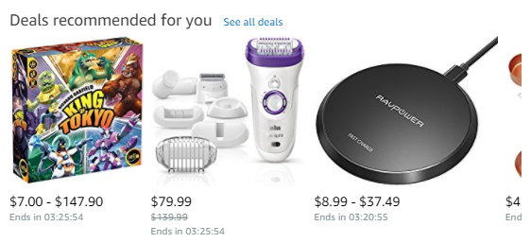
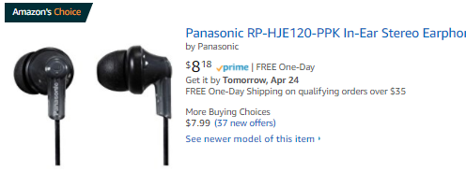
Machine Learning Problems
Problem type
Description
Example
Ranking
Helping users find the most relevant thing
Recommendations across the website
Amazon’s Choice
Recommendation
Giving users the thing they may be most interested in
Classification
Figuring out what kind of thing something is
Regression
Predicting a numerical value of a thing
Clustering
Putting similar things together
Anomaly Detection
Finding uncommon things

Slide 10
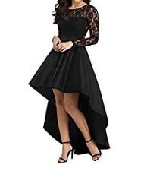
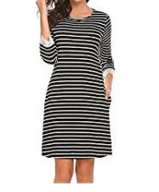
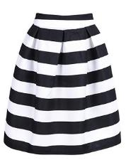
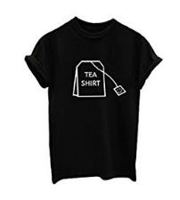
Machine Learning Problems
Problem type
Description
Example
Ranking
Helping users find the most relevant thing
Product classification for our catalog
Recommendation
Giving users the thing they may be most interested in
Classification
Figuring out what kind of thing something is
High-Low Dress
Straight Dress
Regression
Predicting a numerical value of a thing
Clustering
Putting similar things together
Anomaly Detection
Finding uncommon things
Striped Skirt
Graphic Shirt

Slide 11

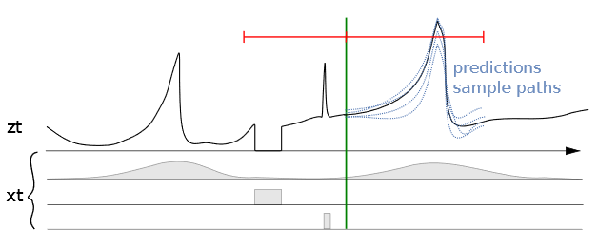
Machine Learning Problems
Problem type
Description
Example
Ranking
Helping users find the most relevant thing
Predicting sales for specific ASINs
Recommendation
Giving users the thing they may be most interested in
Classification
Figuring out what kind of thing something is
Regression
Predicting a numerical value of a thing
Clustering
Putting similar things together
Anomaly Detection
Finding uncommon things
Seasonality | Out of stock | Promotions

Slide 12
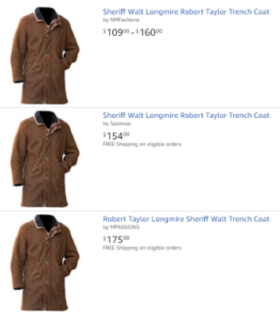
Machine Learning Problems
Problem type
Description
Example
Ranking
Helping users find the most relevant thing
Close-matching for near-duplicates
Recommendation
Giving users the thing they may be most interested in
Classification
Figuring out what kind of thing something is
Regression
Predicting a numerical value of a thing
Clustering
Putting similar things together
Anomaly Detection
Finding uncommon things

Slide 13


Machine Learning Problems
Problem type
Description
Example
Ranking
Helping users find the most relevant thing
Fruit freshness
Recommendation
Giving users the thing they may be most interested in
Before
After
Classification
Figuring out what kind of thing something is
Regression
Predicting a numerical value of a thing
Clustering
Putting similar things together
Good
Damage
Serious Damage
Decay
Anomaly Detection
Finding uncommon things

Slide 14
Supervised vs. Unsupervised Learning
Supervised Learning
Supervised Learning
Data is provided with the correct labels
Unsupervised Learning
Regression (Quantity)
Classification (Category)
Data is provided without labels
K-Means
Collaborative Filtering
PCA
Linear
KNN
Neural Net
Trees
SVM
Logistic

Slide 15
Supervised Learning - Regression
Supervised Learning
Data is provided with the correct labels
Regression (Quantity)
Classification (Category)
Target
Features
Price | Bedrooms | SqFootage | Age
280.000 | 3 | 3292 | 14
210.030 | 2 | 2465 | 6
Linear
KNN
Neural Net
Trees
SVM
Logistic

Slide 16
Supervised Learning - Classification
Supervised Learning
Data is provided with the correct labels
Regression (Quantity)
Classification (Category)
Target
Features
Star | Points | Edges | Size
1 | 5 | 10< | 150
0 | 0 | >9 | 750
Linear
KNN
Neural Net
Trees
SVM
Logistic

Slide 17
Unsupervised Learning - Clustering
Unsupervised Learning
Data is provided without labels
Features
K-Means
Collaborative Filtering
PCA
Source | Region | Employees | GMS
Google | West | 1-50 | 150K
LinkedIn | East | 100-200 | 750K

Slide 18
Unsupervised Learning - Clustering
Unsupervised Learning
Data is provided without labels
Features
K-Means
Collaborative Filtering
PCA
Source | Region | Employees | GMS
Google | West | 1-50 | 150K
LinkedIn | East | 100-200 | 750K

Slide 19
Machine Learning and Statistics
ML optimizes on predictive performance, while statistics places importance on interpretability and parsimony/simplicity.
ML | Statistics | Simply Put
Label/Target | Dependent/Response/Output Variable | The thing you’re trying to predict.
Feature | Independent/Explanatory/Input Variable | Data that help you make predictions.
Feature Engineering | Transformation | Reshaping data to get more value.
Feature Selection | Variable/Subset Selection | Using the most valuable data.

Slide 20
Topics for Day 1
Introduction to Machine Learning
Data Processing
Model Evaluation Metrics
Text Processing
Bag of Words Method (BoW)
K Nearest Neighbors Model (KNN)
Final Project

Slide 21
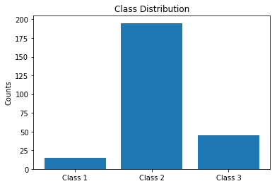
Data Class Imbalance
In imbalanced datasets, the number of data points for each class is not equally distributed.
Often, there are many data points for one class (the dominant class), but much fewer for the other classes (the rare classes).

Slide 22
Data Class Imbalance
How to solve class imbalance problem?
Downsampling: Downsample the dominant class(es).
Upsampling: Upsample the rare or small class(es). It creates identical records.
Data generation: Create new records that are similar but not identical. For example: In computer vision, create similar images distorting original images by rotating, introducing noise or skewing.
Up/down weights: For a model that uses a cost function, assign higher weights to rare class(es) and lower weights to dominant class(es).

Slide 23
Handling Missing Data
How can we handle the missing values of the following product review dataset?
title | text | rating | isPositive
Good | I was very happy with this purchase… | 4.0 | 1
Expensive | Not worth the price. Most of the… |  | 0
 | It works fast and … | 5.0 | 1
Not impressed | Low quality material. I could … | 2.0 | 0
Broken! |  | 1.0 | 0
Nice | I have been waiting for the … | 5.0 | 1
?
?
?

Slide 24
Handling Missing Data
Drop rows and/or columns with missing values: Remove those rows and/or columns from the dataset.
Less training data samples and/or less features can lead to overfitting/underfitting.
Imputation: Fill-in the missing values.
Average imputation: Only for numerical values. Take the average of the values in that column.
Common point imputation: Only for categorical data. Assign the most common value for that column.
Placeholder: You can assign a common value for missing data location.
Model development: Develop a machine learning model that will learn from the complete data points and predict the missing values. For example: Datawig from AWS labs: https://github.com/awslabs/datawig

Slide 25
Training - Validation - Test Datasets
Original Dataset
Training Set
Training Set
(used to train the model)
Validation Set
(used for unbiased evaluation of the model)
Test Set
Test Set
(used for final evaluation of the model)
Train, tune and validate the model (multiple times!)
(Final) Model Testing
Why do we divide the data into these three sub-datasets?
How do we make sure our model generalizes well?

Slide 26
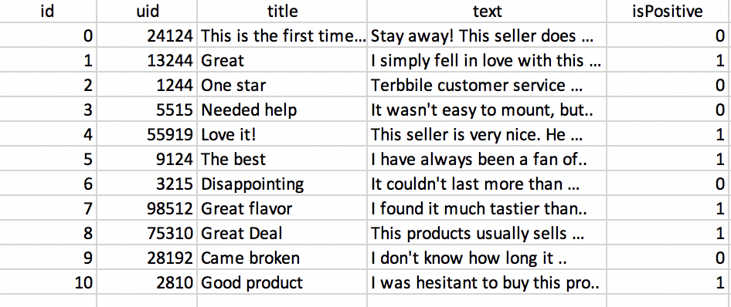
Training - Validation - Test Datasets
Original Dataset
Training Set
Training Set
(used to train the model)
Validation Set
(used for unbiased evaluation of the model)
Test Set
Test Set
(used for final evaluation of the model)
Train, tune and validate the model (multiple times!)
(Final) Model Testing
It is good practice to shuffle the dataset before the split to avoid bias in the resulting sets.
Training Set
Validation Set
Test Set

Slide 27
Model Evaluation - Underfitting
Underfitting: Model is not good enough to describe the relationship between the input data (x, y) and the output (Class).
Model is too simple to capture important patterns of training set.
Corresponds to high bias - results show systematic lack of fit in certain regions.
Model will perform poorly on training and test.
y
Class 1
Class 2
Class 1
Class 2
x

Slide 28
Model Evaluation - Overfitting
Overfitting: Model memorizes or imitates training data, and doesn’t generalize well on new “unseen” data (test data).
Model is too complex, picks up the noise instead of the underlying relationship.
Corresponds to high variance – small changes in the data lead to big result changes.
Model will perform well on training, but poorly on test.
y
Class 1
Class 2
Class 1
Class 2
x

Slide 29
Model Evaluation - Appropriate Fitting
Appropriate fitting: Model captures the general relationship between the input data (x, y) and the output (Class).
Bias-variance trade-off, model not too simple, not too complex.
Corresponds to low bias and low variance, picks up the underlying relationship rather than the noise in the training.
Model will perform good enough on training and test.
y
Class 1
Class 2
Class 1
Class 2
x
Error ~ Bias + Variance

Slide 30
Topics for Day 1
Introduction to Machine Learning
Data Processing
Model Evaluation Metrics
Text Processing
Bag of Words Method (BoW)
K Nearest Neighbors Model (KNN)
Final Project

Slide 31
Model Performance - Metrics
Regression (Continuous)
Mean Squared Error
R Squared
Classification (Categorical)
Accuracy
Precision, Recall, F1-score

Slide 32
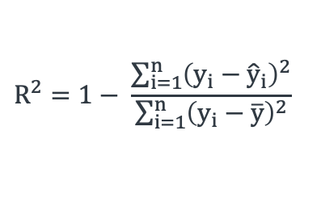
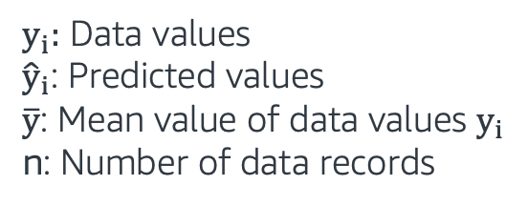
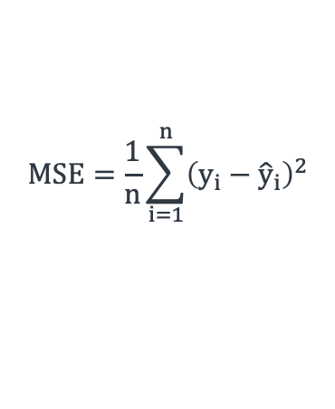
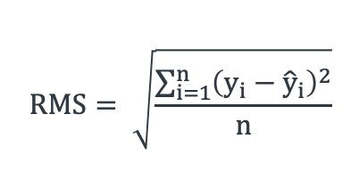
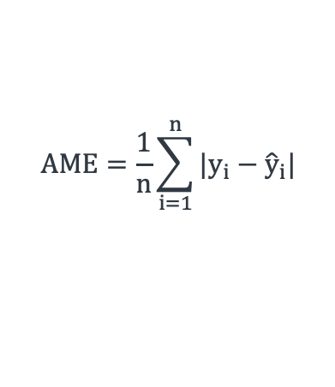
Evaluating Regression Models
Metrics | Equations
Mean Squared Error (MSE)
Root Mean Squared Error (RMSE)
Absolute Mean Error (AME)
R Squared (R²)
$y_{i}:$ Data values
${\hat{y}}_{i}$: Predicted values
$\overline{y}$: Mean value of data values $y_{i}$
n: Number of data records
$$MSE=\frac{1}{n}\sum_{i=1}^{n}{{\left(y_{i}−{\hat{y}}_{i}\right)}^{2}}$$
$$RMS= \sqrt{\frac{\sum_{i=1}^{n}{{\left(y_{i}−{\hat{y}}_{i}\right)}^{2}}}{n}}$$
$$AME=\frac{1}{n}\sum_{i=1}^{n}{{|y}_{i}−{\hat{y}}_{i}|}$$
$$R^{2}=1− \frac{\sum_{i=1}^{n}{{\left(y_{i}−{\hat{y}}_{i}\right)}^{2}}}{\sum_{i=1}^{n}{{\left(y_{i}−\overline{y}\right)}^{2}}}$$

Slide 33
Evaluating Classification Models
Prediction
True Positive: Predicted ‘Positive’
when the actual is ‘Positive’
False Positive: Predicted ‘Positive’
when the actual is ‘Negative’
False Negative: Predicted ‘Negative’
when the actual is ‘Positive’
True Negative: Predicted ‘Negative’
when the actual is ‘Negative’
Positive
Negative
True Positive
False Negative
Positive
19
2
True State
False Positive
True Negative
Negative
1
3

Slide 34
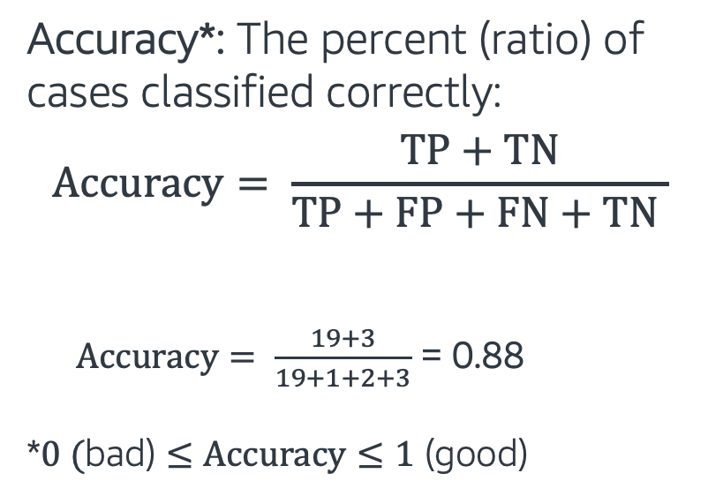
Classification - Accuracy
Prediction
Positive
Negative
Accuracy*: The percent (ratio) of cases classified correctly:
$$Accuracy= \frac{TP+TN}{TP+FP+FN+TN }$$
$Accuracy= \frac{19+3}{19+1+2+3}$ = 0.88
*$0 (\text{bad}\text{)}≤Accuracy≤1\text{ (}\text{good}\text{)}$
True Positive
False Negative
Positive
19
2
True State
False Positive
True Negative
Negative
1
3

Slide 35
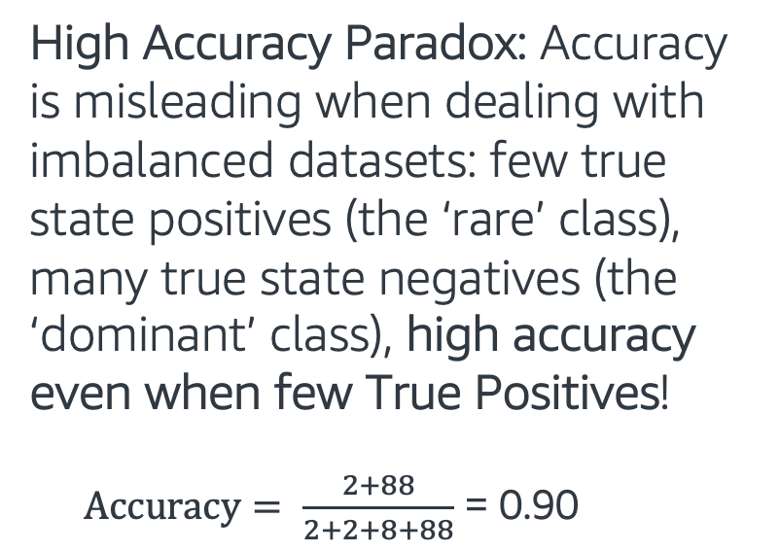
Classification - Accuracy
Prediction
Positive
Negative
High Accuracy Paradox: Accuracy is misleading when dealing with imbalanced datasets: few true state positives (the ‘rare’ class), many true state negatives (the ‘dominant’ class), high accuracy even when few True Positives!
$Accuracy= \frac{2+88}{2+2+8+88}$ = 0.90
True Positive
False Negative
Positive
2
8
True State
False Positive
True Negative
Negative
2
88

Slide 36
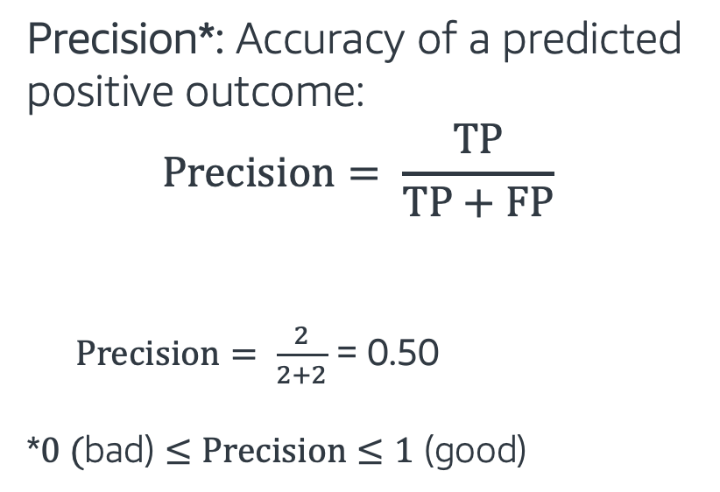
Classification – Precision
Prediction
Positive
Negative
Precision*: Accuracy of a predicted positive outcome:
$$Precision= \frac{TP}{TP+FP}$$
$Precision= \frac{2}{2+2}$ = 0.50
*$0 (\text{bad}\text{)}≤Precision≤1\text{ (}\text{good}\text{)}$
True Positive
False Negative
Positive
2
8
True State
False Positive
True Negative
Negative
2
88

Slide 37
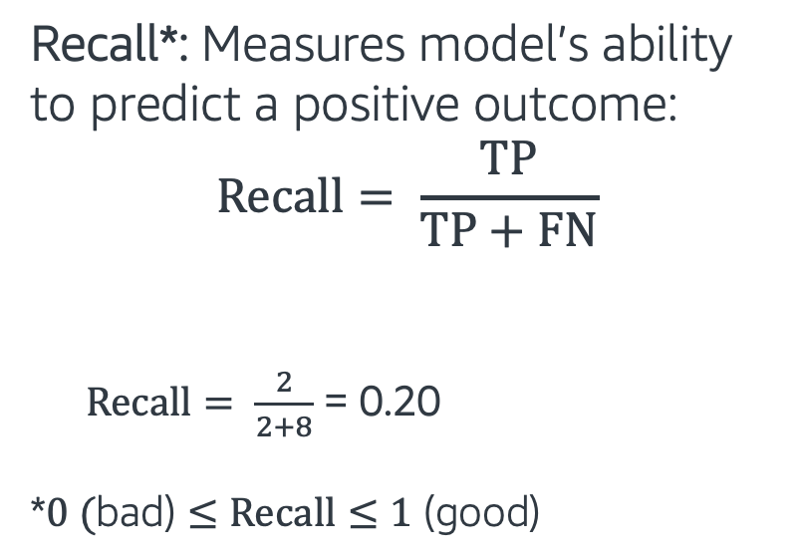
Classification – Recall
Prediction
Positive
Negative
Recall*: Measures model’s ability to predict a positive outcome:
$$Recall= \frac{TP}{TP+FN}$$
$Recall= \frac{2}{2+8}$ = 0.20
*$0 (\text{bad}\text{)}≤Recall≤1\text{ (}\text{good}\text{)}$
True Positive
False Negative
Positive
2
8
True State
False Positive
True Negative
Negative
2
88

Slide 38
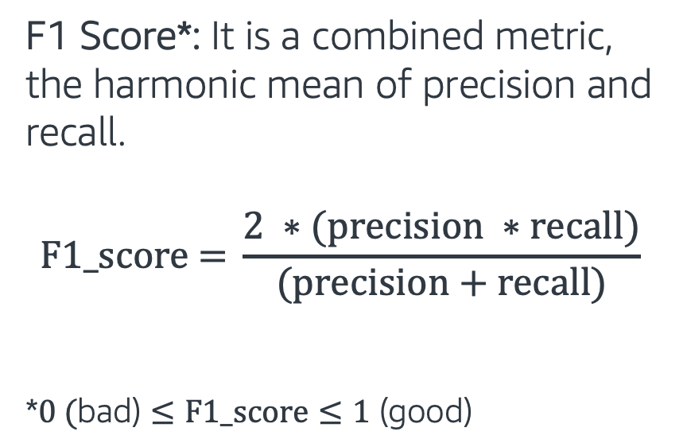
Classification - F1 Score
F1 Score*: It is a combined metric, the harmonic mean of precision and recall.
$$\text{F}\text{1_}\text{score}\text{ = }\frac{2 ∗(precision ∗recall)}{(precision+recall)}$$
$$\text{*}0 (\text{bad}\text{)}≤\text{F}\text{1_}\text{score}≤1\text{ (}\text{good}\text{)}$$
Recall
F1 score
Precision

Slide 39
Machine Learning with Text Data
Aside from dealing with imbalanced datasets and imputing missing values, text data is difficult to work with.
ML models need well-defined numerical data - to train ML models on text data we first extract numerical values from the text data
Text data
Text preprocessing
(Cleaning and formatting)
Vectorizer
(Convert to numbers)
Train ML Model using numerical data
Stop words removal
Stemming, Lemmatization
Bag of Words (BoW)
K Nearest Neighbors (KNN)

Slide 40
Topics for Day 1
Introduction to Machine Learning
Data Processing
Model Evaluation Metrics
Text Processing
Bag of Words Method (BoW)
K Nearest Neighbors Model (KNN)
Final Project

Slide 41
Tokenization
Tokenization: Separates text into small parts by white space and punctuation.
Sentence: “I don’t like eggs.”
Tokens: “I”, “do”, “n’t”, “like”, “eggs”, “.”
We base our next processes on these tokens.

Slide 42
Text Cleaning Operations
We can encounter different types of problems. Some common examples:
Leading/trailing white spaces and extra white spaces/tabs
HTML and XML markups
Misspellings
Acronyms: NASA, ETA etc
Phone numbers, dates: +14256565, 12/11/2013

Slide 43
Stop Words Removal
Some words commonly appear in our texts, but they don’t contribute too much to the overall meaning. We remove them from the text.
Common stop words: “a”, “the”, “so”, “is”, “it”, “at”, “in”, “this”, “there”, “that”, “my”
Example:
Original sentence: “There is a tree near the house”
Without stop words: “tree near house”

Slide 44
Stemming
Stemming: Set of rules to slice a string to a substring that usually refers to a more general meaning.
The goal is to remove word affixes (particularly suffixes) such as “s”, “es”, “ing”, “ed”, etc.
“playing”
“played” “play”
”plays”
It is a simple method and it doesn’t usually work with irregular forms such as irregular verbs: “taught”, “brought”, etc.

Slide 45
Lemmatization
Lemmatization: It looks up the words in dictionary and returns the “head” word called a “lemma”
It handles more situations and usually works better than stemming.
-“taught” -”am”
-“teaching” “teach” -”is” “be”
-“teaches” -“are”
For the best results, correct word position tags should be provided: “adjective”, “noun”, “verb” etc.

Slide 46
Stemming vs. Lemmatization
As we pointed out, lemmatization is a more complex method and usually works better.
Original sentence: "the children are playing outside. the weather was better yesterday."
Stemming => “the children are play outside. the weather was better yesterday”
Lemmatization => “the child be play outside. the weather be good yesterday”

Slide 47
Text Processing - Hands on
In this exercise, we will go over:
Simple text cleaning processes
Stop words removal
Stemming, Lemmatization
Follow through this notebook: “EMBK-NLP-DAY1-TEXT-PROCESS-NB.ipynb”

Slide 48
Topics for Day 1
Introduction to Machine Learning
Data Processing
Model Evaluation Metrics
Text Processing
Bag of Words Method (BoW)
K Nearest Neighbors Model (KNN)
Final Project

Slide 49
Bag of Words (BoW)
Text data is difficult to work with. Machine learning models need well-defined numerical data.
Bag of Words method converts text data into numerical features.
We call this operation “Feature extraction”, as it gives us important information about the text in a numeric form.
With BoW, we get a number for each word in a document. It can be binary (present or not), word counts or frequencies.

Slide 50
Bag of Words (BoW) - Binary
Example:
document_1 = “This document is the first document”
document_2 = “This document is the second document”
document_3 = “and this is the third one”
Binary features (word in the document or not):
vocabulary = {“and”, “document”, “first”, “is”, “one”, “second”, “the”, “third”, “this”}
 | and | document | first | is | one | second | the | third | this
document_1 | 0 | 1 | 1 | 1 | 0 | 0 | 1 | 0 | 1
document_2 | 0 | 1 | 0 | 1 | 0 | 1 | 1 | 0 | 1
document_3 | 1 | 0 | 0 | 1 | 1 | 0 | 1 | 1 | 1

Slide 51
Bag of Words (BoW) - Counts
Example:
document_1 = “This document is the first document”
document_2 = “This document is the second document”
document_3 = “and this is the third one”
Word counts (how many times is the word in the document):
vocabulary = {“and”, “document”, “first”, “is”, “one”, “second”, “the”, “third”, “this”}
 | and | document | first | is | one | second | the | third | this
document_1 | 0 | 2 | 1 | 1 | 0 | 0 | 1 | 0 | 1
document_2 | 0 | 2 | 0 | 1 | 0 | 1 | 1 | 0 | 1
document_3 | 1 | 0 | 0 | 1 | 1 | 0 | 1 | 1 | 1

Slide 52
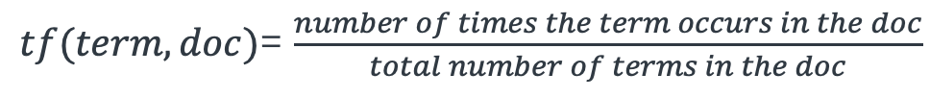
Term Frequencies
Term Frequency*: How important is a word to the document
document_1 = “This document is the first document”
document_2 = “This document is the second document”
document_3 = “and this is the third one”
*sklearn automatically normalizes the term frequencies vectors, by their Euclidean (l2) norm
$tf(term, doc)$= $\frac{number of times the term occurs in the doc}{total number of terms in the doc}$
vocabulary = {“and”, “document”, “first”, “is”, “one”, “second”, “the”, “third”, “this”}
 | and | document | first | is | one | second | the | third | this
document_1 | 0 | 0.707 | 0.353 | 0.353 | 0 | 0 | 0.353 | 0 | 0.353
document_2 | 0 | 0.707 | 0 | 0.353 | 0 | 0.353 | 0.353 | 0 | 0.353
document_3 | 0.408 | 0 | 0 | 0.408 | 0.408 | 0 | 0.408 | 0.408 | 0.408

Slide 53
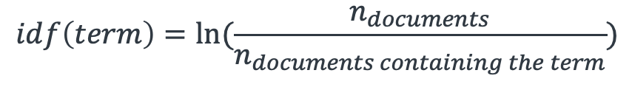
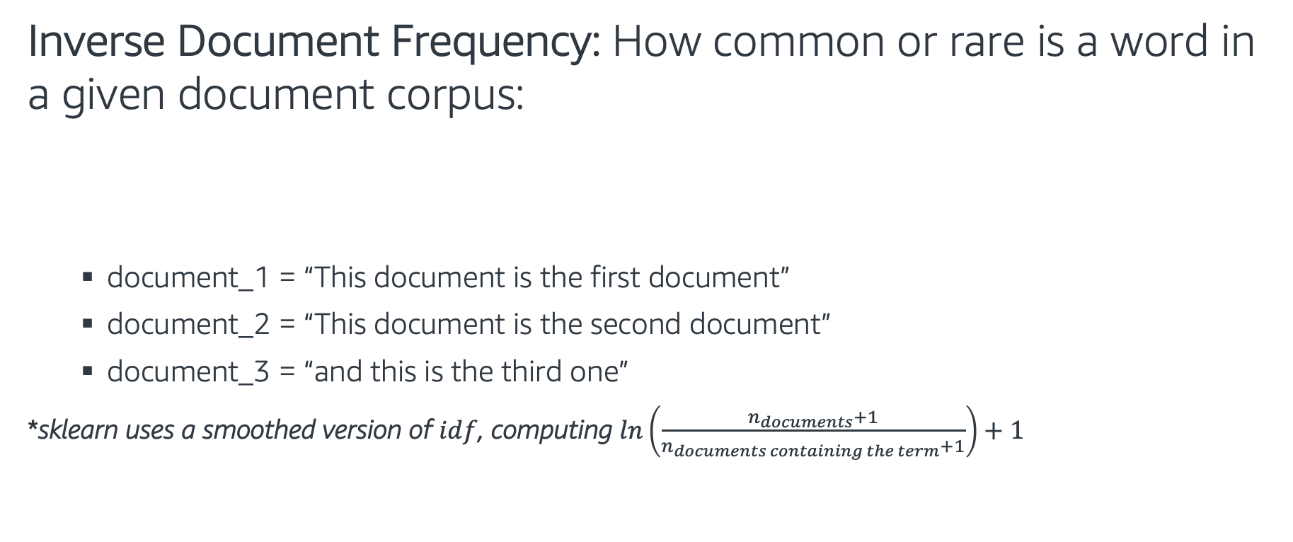
Inverse document frequency (IDF)
Inverse Document Frequency: How common or rare is a word in a given document corpus:
document_1 = “This document is the first document”
document_2 = “This document is the second document”
document_3 = “and this is the third one”
*sklearn uses a smoothed version of $idf$, computing $\ln\left(\frac{n_{documents}+1}{n_{documents containing the term}+1}\right)+1$
$$idf\left(term\right)=ln⁡(\frac{n_{documents}}{n_{documents containing the term}})$$
vocabulary = {“and”, “document”, “first”, “is”, “one”, “second”, “the”, “third”, “this”}
 | and | document | first | is | one | second | the | third | this
document_1 | 1.693 | 1.287 | 1.693 | 1 | 1.693 | 1.693 | 1 | 1.693 | 1

Slide 54
Term Frequency – Inverse Doc. Freq.
Term Frequency - Inverse Document Frequency*:
document_1 = “This document is the first document”
document_2 = “This document is the second document”
document_3 = “and this is the third one”
*sklearn automatically normalizes the term frequencies vectors, by their Euclidean (l2) norm
$$tf_{idf}(term,doc)=tf\left(term, doc\right)∗idf(term)$$
vocabulary = {“and”, “document”, “first”, “is”, “one”, “second”, “the”, “third”, “this”}
 | and | document | first | is | one | second | the | third | this
document_1 | 0 | 0.728 | 0.479 | 0.283 | 0 | 0 | 0.283 | 0 | 0.283
document_2 | 0 | 0.728 | 0 | 0.283 | 0 | 0.479 | 0.283 | 0 | 0.283
document_3 | 0.497 | 0 | 0 | 0.294 | 0.497 | 0 | 0.294 | 0.497 | 0.294

Slide 55
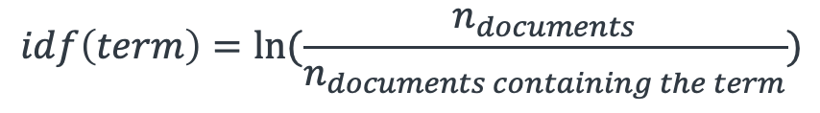
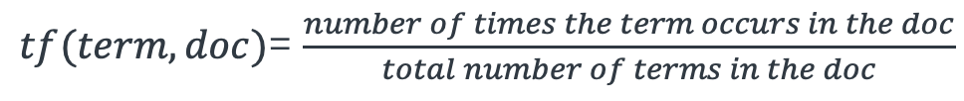
Term Frequencies - Summary
Term frequency (TF): | Increases the weight for common words in a document.
Inverse document frequency (IDF): | Decreases the weights for commonly used words and increases weights for rare words in the vocabulary.
Term Freq. Inverse Doc. Freq (TF-IDF): | Combines term frequency and inverse document frequency.
$tf(term, doc)$= $\frac{number of times the term occurs in the doc}{total number of terms in the doc}$
$$idf\left(term\right)=ln⁡(\frac{n_{documents}}{n_{documents containing the term}})$$
$$tf_{idf}(term,doc)=tf\left(term, doc\right)∗idf(term)$$

Slide 56
Feature Extraction - Hands on
Sklearn provides nice implementations of the Bag of Words method.
In this exercise, we will convert text data to numerical values, getting these types of features:
Binary
Word Counts
Term Frequency (TF)
Term Freq – Inverse Document frequency (TF-IDF)
Follow through this notebook: “EMBK-NLP-DAY1-BOW-NB.ipynb”

Slide 57
Topics for Day 1
Introduction to Machine Learning
Data Processing
Model Evaluation Metrics
Text Processing
Bag of Words Method (BoW)
K Nearest Neighbors Model (KNN)
Final Project

Slide 58
K Nearest Neighbors (KNN)
K Nearest Neighbors (KNN) model predicts new data points based on the similar other records in a dataset.
Algorithm:
Find “K” similar records
For classification (predict class):
Take the majority class of those K records
For regression (predict numerical value):
Take the average value of those K records
Class 1:
Class 2:
X₂
X₁

Slide 59
K Nearest Neighbors (KNN) Classifier
Assume a dataset:
Two classes: and
Two features X₁ and X₂
K Nearest Neighbor Model:
K=3
Class 1:
Class 2:
X₂
X₁

Slide 60
K Nearest Neighbors (KNN) Classifier
Assume a dataset:
Two classes: and
Two features X₁ and X₂
K Nearest Neighbor Model:
K=3
What class does belong?
Class 1:
Class 2:
X₂
?
?
X₁

Slide 61

K Nearest Neighbors (KNN) Classifier
Assume a dataset:
Two classes: and
Two features X₁ and X₂
K Nearest Neighbor Model:
K=3
What class does belong?
Look at the closest K points
Pick the majority class:
Class 1:
Class 2:
X₂
?
?
X₁

Slide 62
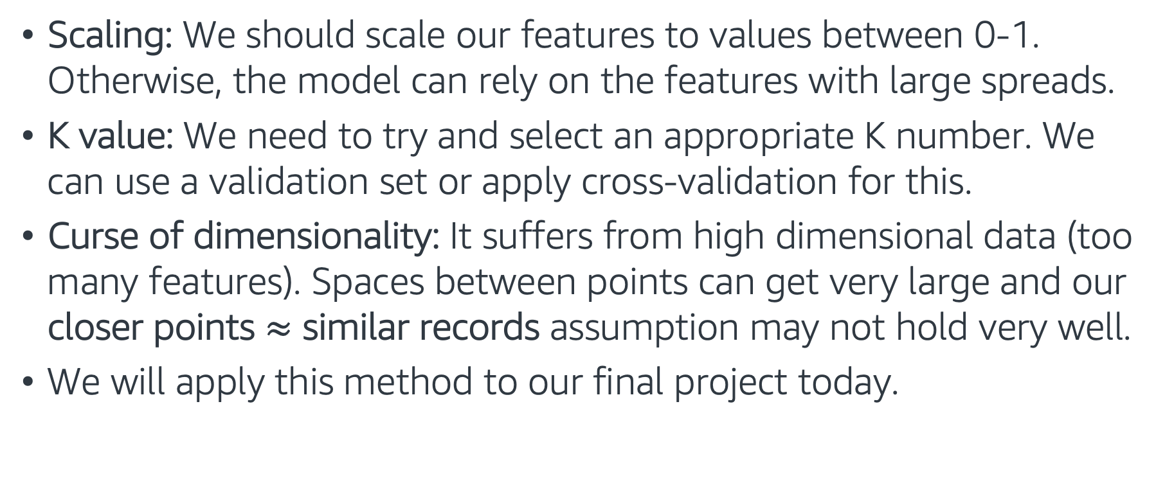
K Nearest Neighbors (KNN) Classifier
Scaling: We should scale our features to values between 0-1. Otherwise, the model can rely on the features with large spreads.
K value: We need to try and select an appropriate K number. We can use a validation set or apply cross-validation for this.
Curse of dimensionality: It suffers from high dimensional data (too many features). Spaces between points can get very large and our closer points $≈$ similar records assumption may not hold very well.
We will apply this method to our final project today.

Slide 63
Putting it all together - Hands on
In this exercise, we work with our review dataset (which is very similar to our final project dataset!) to predict the log_votes field
The exercise covers the following topics:
Training-validation-test split
Text processing and Bag of Words feature extraction
ML Model: K Nearest Neighbors (KNN) Regressor
Follow through this notebook: “EMBK-NLP-DAY1-KNN-NB.ipynb”

Slide 64
Topics for Day 1
Introduction to Machine Learning
Data Processing
Model Evaluation Metrics
Text Processing
Bag of Words Method (BoW)
K Nearest Neighbors Model (KNN)
Final Project

Slide 65
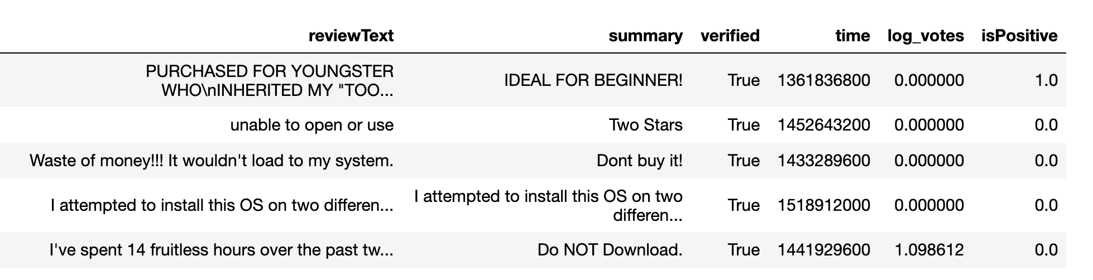
Final Project – Sentiment Analysis
Data: Customer reviews. Let's look at first 5 rows of the training dataset:
Task: Train a classifier to predict the isPositive field for the test dataset.
Follow through this notebook ”EMBK-NLP-DAY1-FINAL-STUDENT-NB.ipynb” to start on the final project.

Slide 66
Notebooks for Day 1
EMBK-NLP-DAY1-TEXT-PROCESS-NB.ipynb: Text processing
EMBK-NLP-DAY1-BOW-NB.ipynb: Bag of Words Features
EMBK-NLP-DAY1-KNN-NB.ipynb: KNN for Regression
EMBK-NLP-DAY1-FINAL-STUDENT-NB.ipynb: Final Project Walkthrough for Day 1
EMBK-NLP-DAY1-FINAL-SOLUTION-NB.ipynb: Final Project Solution for Day 1

Slide 67
Looking Ahead - Day 2
Tree-based Models
Regression Models
Optimization
Regularization
Hyperparameter Tuning
AWS AI/ML Services and Model Deployment

